Slide 1



Digital Humanities in Computer Vision
Muhammad Ahtasham 2020270
Ahsham Abdullah
2020057
Muhammad Shees 2020359

Slide 2



Facial recognition
Image restoration
Image classification
Object detection
Image segmentation:

Slide 3


Facial Recognition:

Slide 4

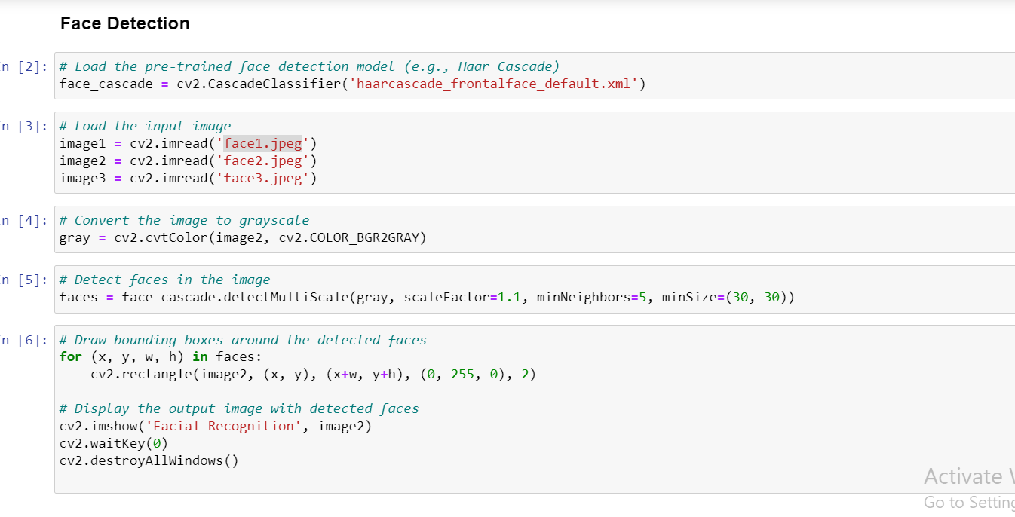


Slide 5
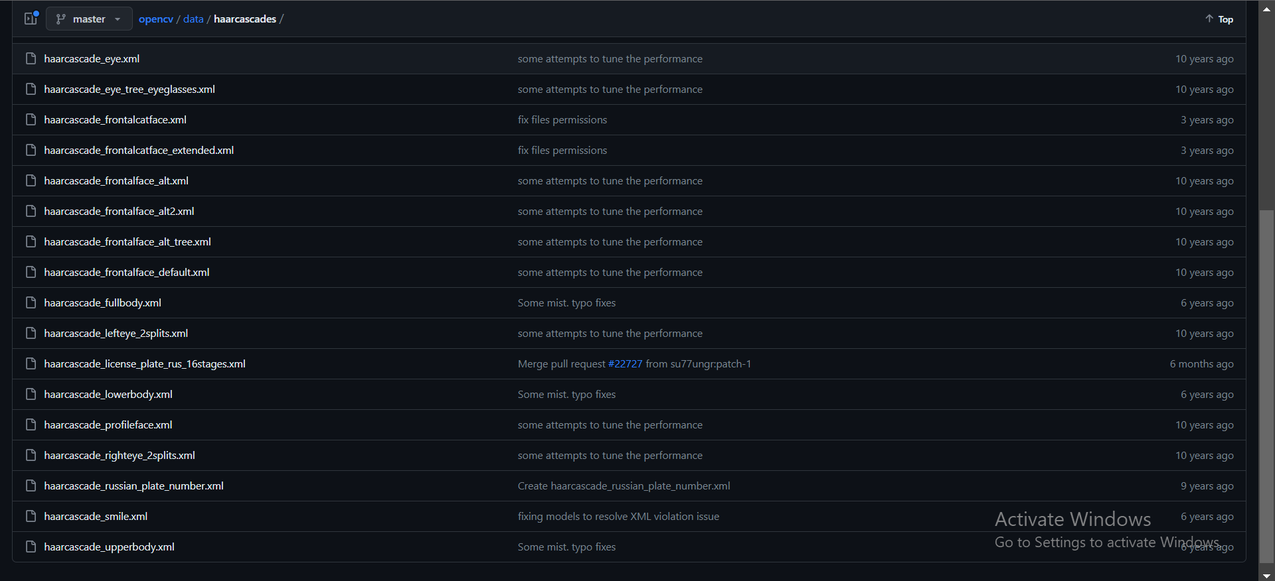
https://github.com/opencv/opencv/tree/master/data/haarcascades

Slide 6


Image Restoration

Slide 7


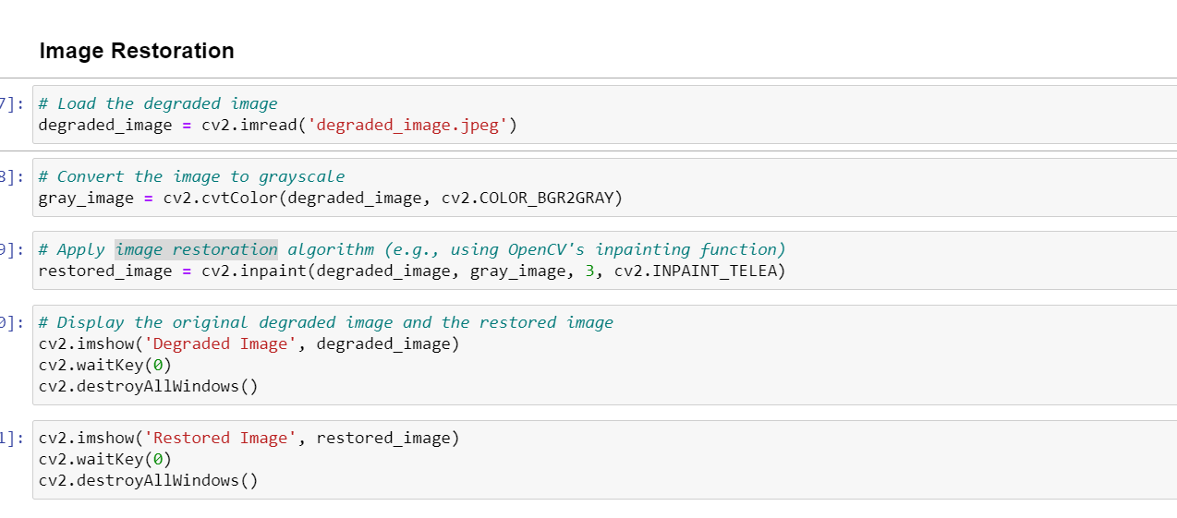


Slide 8



Image Segmentation

Slide 9
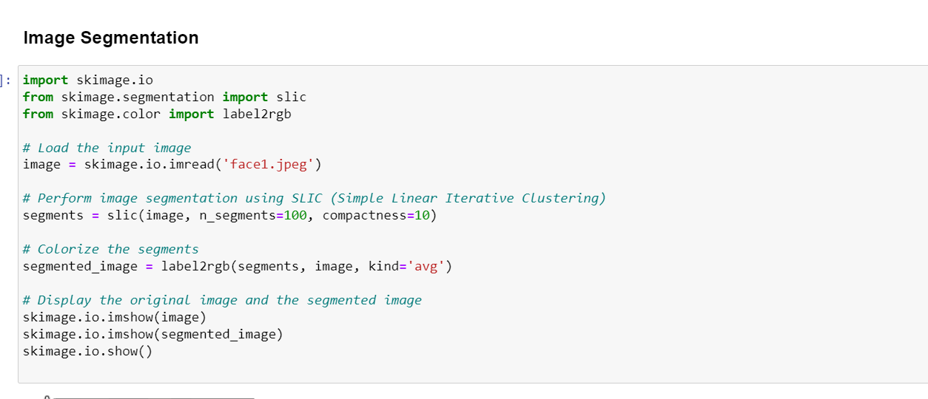


Slide 10
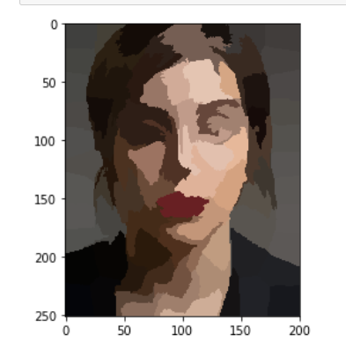
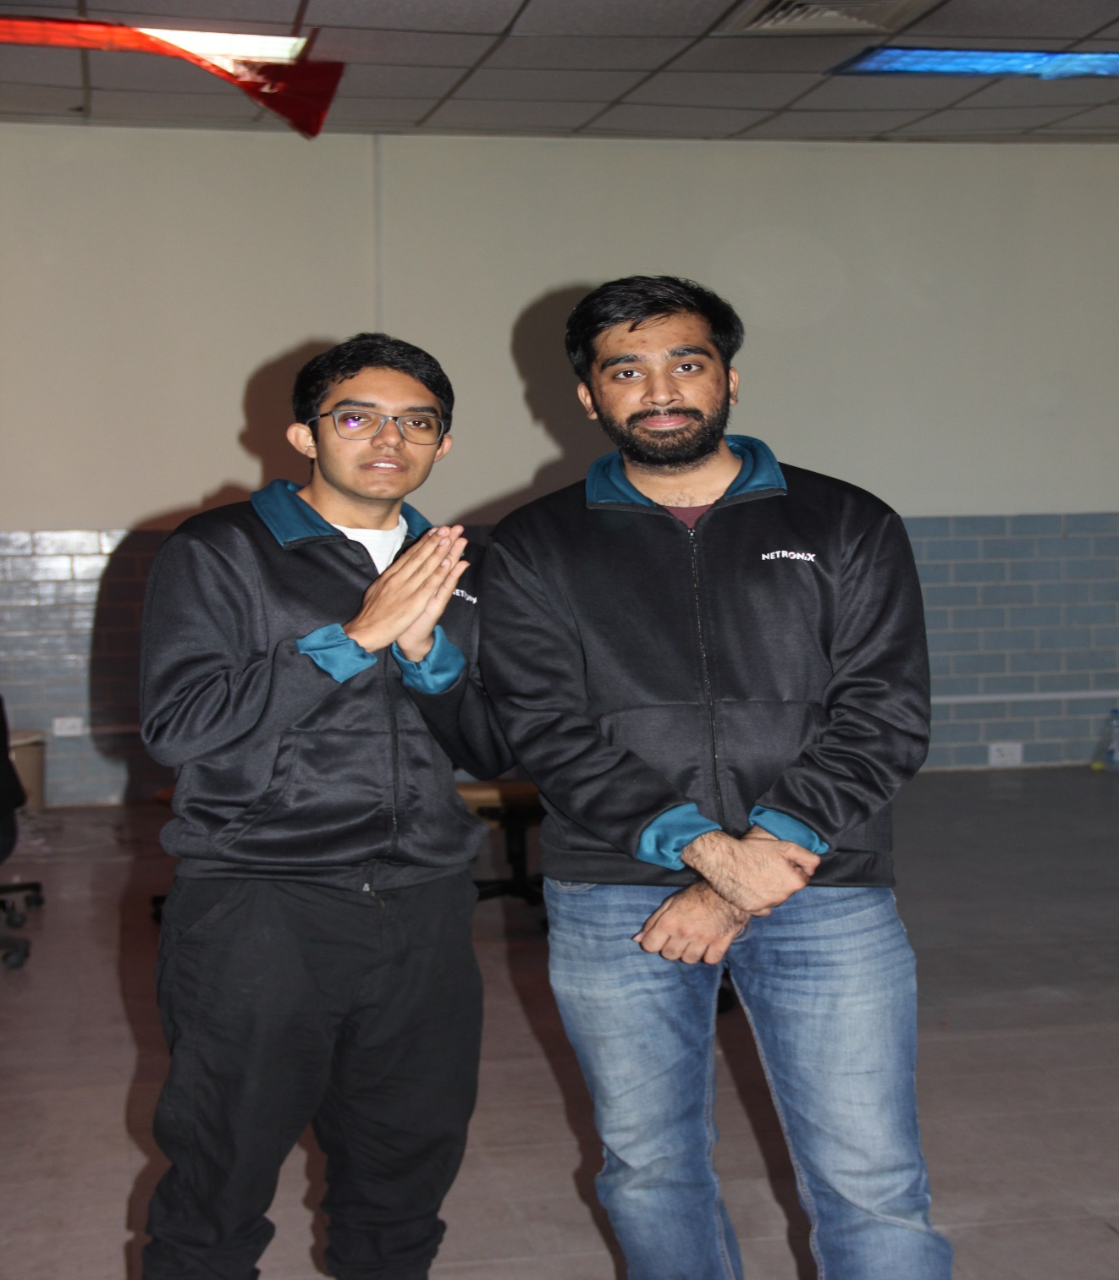
Input

Slide 11
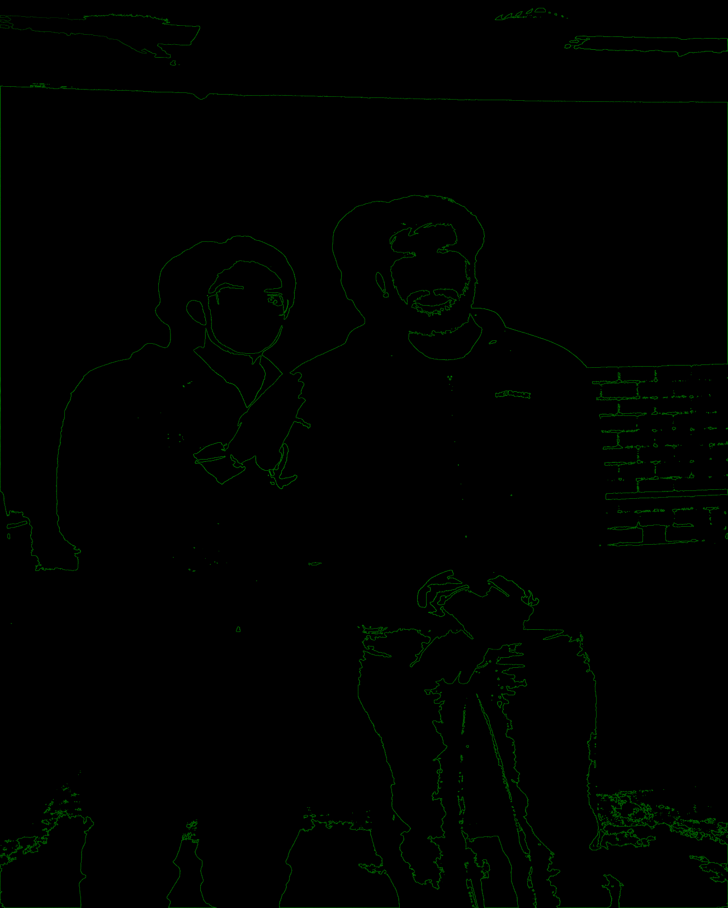
Output

Slide 12
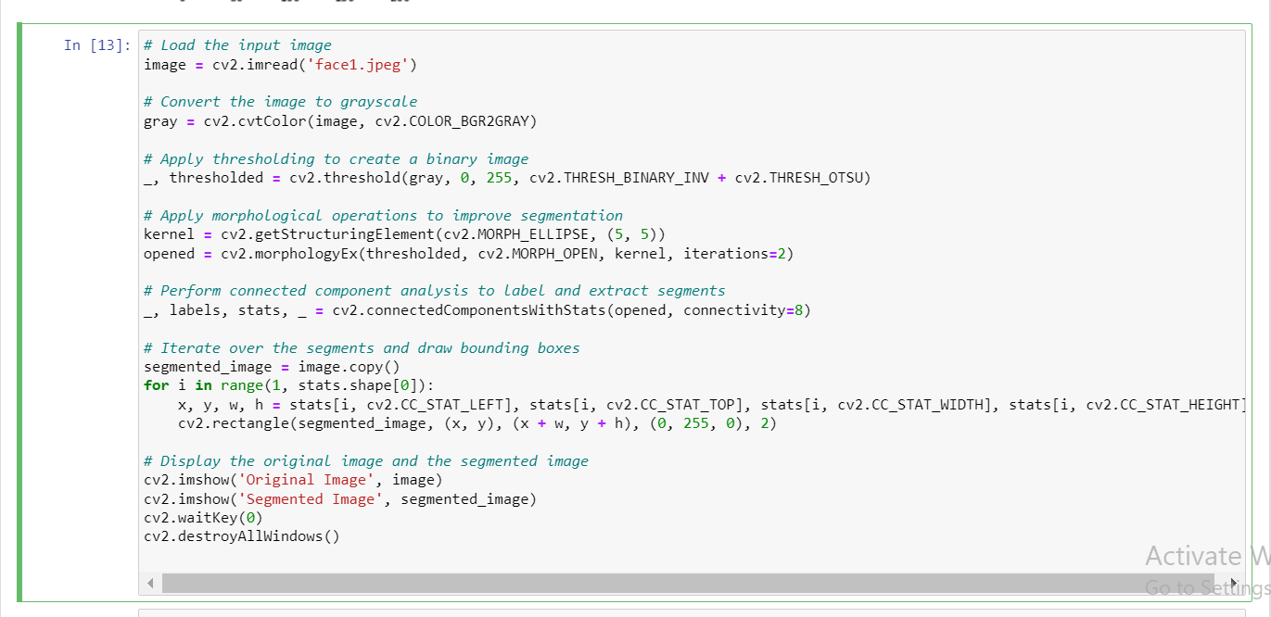

Slide 13
Methods and Frameworks
Skimage io
Open CV
Image Denoising
Object detection
Image segmentation

Slide 14
Practical Applications
Medical Imaging
Satellite Imagery
Autonomous Driving
Forensic Analysis
Historical Document Preservation

Slide 15
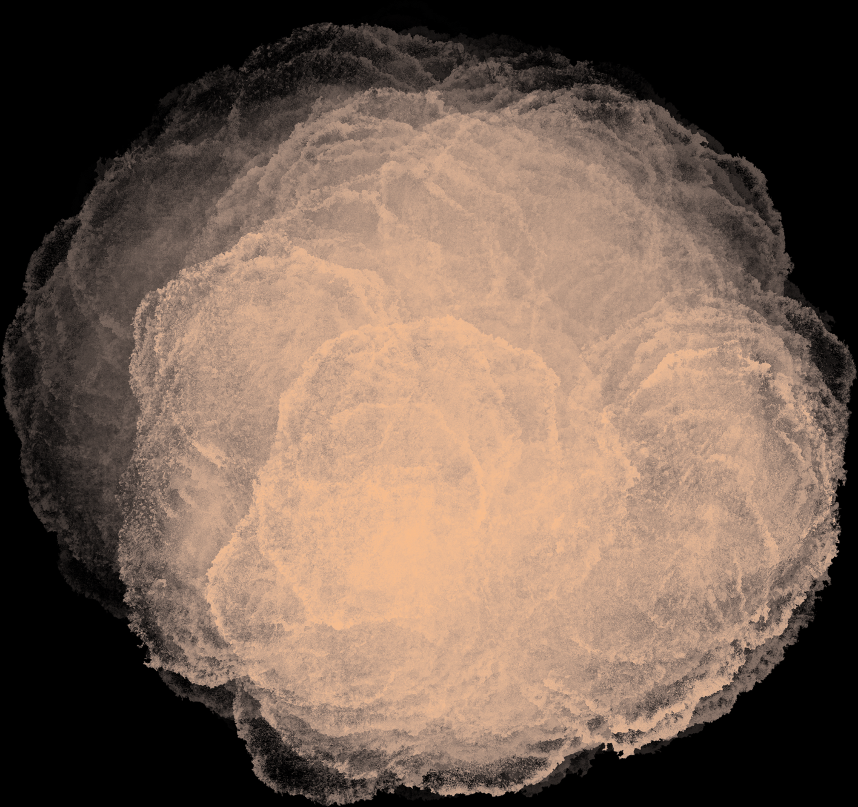
Thank
you
Github Link: https://github.com/ahsham123/ImageSegmentation

